Slide 1

Employee Attrition
Deandre Connor

Slide 2


Topics
Hourly Rates vs Job Title
Total Working Years Vs ID
Job Satisfaction Vs ID

Slide 3


Intro Quote
“People need to feel safe to be who they are—to speak up when they have an idea, or to speak out when they feel something isn't right.”
― Eunice Parisi-Carew

Slide 4



Hourly Rates Vs. Job Title

Slide 5
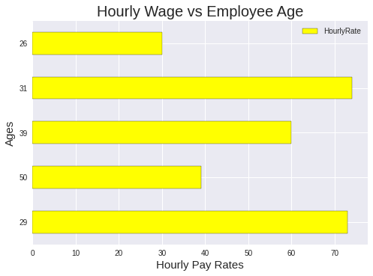
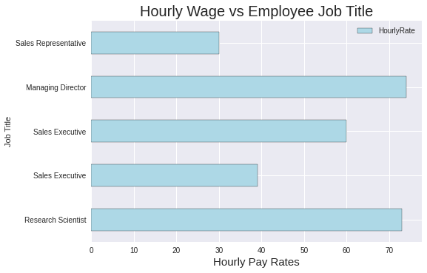
Graph of Age & Job title

Slide 6

Summary Of Graphs
Graph One - Employee Age vs Hourly Wage
The graph was made by taking the employees ages and their pay rate to compare.
The reason I decided on these employees is because I would like to highlight the different job titles and pay ranges.

Slide 7
Coding For graph
plt.style.use('seaborn')
data = {'Job Title': ['Research Scientist', 'Sales Executive', 'Sales Executive', 'Managing Director', 'Sales Representative'],
'HourlyRate': [73,39,60,74,30]}
employee = pd.DataFrame(data,columns=['Job Title','HourlyRate'])
employee.plot(x ='Job Title', y='HourlyRate', kind = 'barh', color= 'lightblue', edgecolor='black');
plt.title("Hourly Wage vs Employee Job Title", fontsize=20);
plt.xlabel("Hourly Pay Rates", fontsize=15);

Slide 8

Summary Of Graphs
Graph Two - Job Title vs Employee Hourly Wage
Now that I have an Idea of the pay difference, I will use this info to find the difference between distance of work and attrition for these employees.

Slide 9
Coding For graph
plt.style.use('seaborn')
data = {'Job Title': ['Research Scientist', 'Sales Executive', 'Sales Executive', 'Managing Director', 'Sales Representative'],
'HourlyRate': [73,39,60,74,30]}
employee = pd.DataFrame(data,columns=['Job Title','HourlyRate'])
employee.plot(x ='Job Title', y='HourlyRate', kind = 'barh', color= 'lightblue', edgecolor='black');
plt.title("Hourly Wage vs Employee Job Title", fontsize=20);
plt.xlabel("Hourly Pay Rates", fontsize=15);

Slide 10
attrition

Slide 11




attrition Defined:
Before we continue let's define attrition!
Staff attrition refers to the loss of employees through a natural process, such as retirement, resignation, elimination of a position, personal health, or other similar reasons. With attrition, an employer will not fill the vacancy left by the former employee.

Slide 12
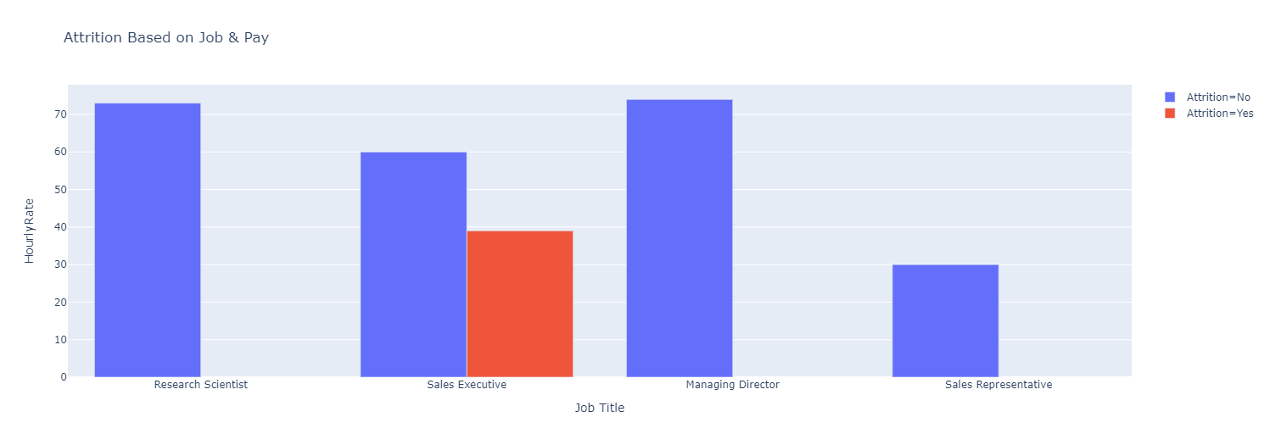

Slide 13
Coding For graph
df_employee = pd.DataFrame({
"Job Title": ['Research Scientist', 'Sales Executive', 'Sales Executive', 'Managing Director', 'Sales Representative'],
"HourlyRate": [73,39,60,74,30],
"Attrition": ['No', 'Yes', 'No', 'No', 'No'],
})
import plotly.express as px
fig = px.bar(df_employee, x="Job Title", y="HourlyRate", color="Attrition", barmode="group", title='Attrition Based on Job & Pay')
fig.show()

Slide 14
Monthly income vs Employee Job Title

Slide 15
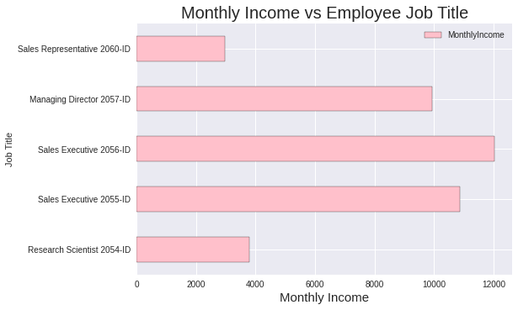

Slide 16
Coding For graph
#This graph shows the Monthly Income Vs the Job Title
plt.style.use('seaborn')
data = {'Job Title': ['Research Scientist 2054-ID', 'Sales Executive 2055-ID', 'Sales Executive 2056-ID', 'Managing Director 2057-ID', 'Sales Representative 2060-ID'],
'MonthlyIncome': [3785,10854,12031,9936,2966]}
employee = pd.DataFrame(data,columns=['Job Title','MonthlyIncome'])
employee.plot(x ='Job Title', y='MonthlyIncome', kind = 'barh', color= 'pink', edgecolor='black');
plt.title("Monthly Income vs Employee Job Title", fontsize=20);
plt.xlabel("Monthly Income", fontsize=15);

Slide 17
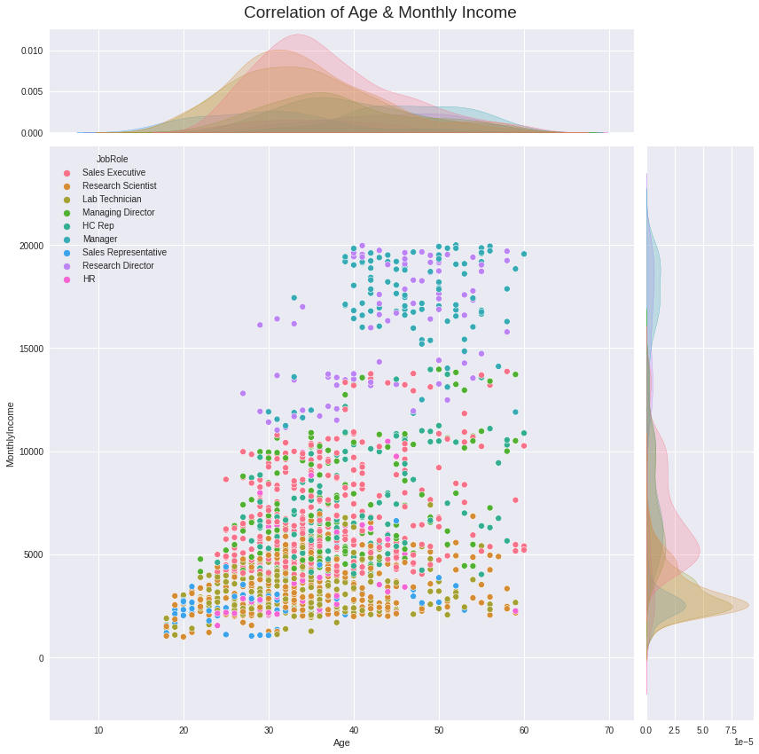
This graph is to show the overall correlation of Age and Monthly income, with the colors of each representing a Job role. This is to give us an idea of Monthly pay scales before we move more into the data for job satisfaction.

Slide 18
Coding For graph
#Shows the Correlation between Age and Monthly Income
p = sns.jointplot(x='Age', y='MonthlyIncome', data=employee,height= 12, kind='scatter', ratio=5, dropna=True, marginal_ticks=True, hue='JobRole');
p.fig.suptitle("Correlation of Age & Monthly Income", fontsize=19);
p.fig.tight_layout()
p.fig.subplots_adjust(top=0.95)

Slide 19
Total Working Years vs Employee ID

Slide 20
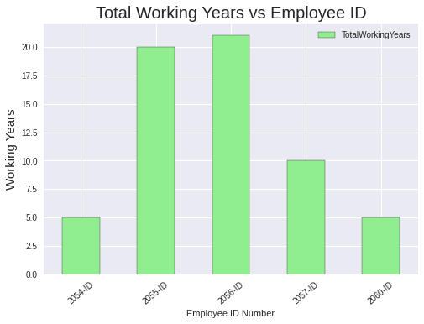

Slide 21
Coding For graph
# This graph shows the working years for each employee ID
plt.style.use('seaborn')
data = {'EmployeeNumber': ['2054-ID', '2055-ID', '2056-ID', '2057-ID', '2060-ID'],
'TotalWorkingYears': [5, 20, 21, 10, 5]}
employee = pd.DataFrame(data,columns=['EmployeeNumber','TotalWorkingYears'])
employee.plot(x ='EmployeeNumber', y='TotalWorkingYears', kind = 'bar', color= 'lightgreen', edgecolor='black');
plt.title("Total Working Years vs Employee ID", fontsize=20);
plt.xticks(rotation = 40);
plt.xlabel('Employee ID Number')
plt.ylabel("Working Years", fontsize=15);

Slide 22
Total Working Years for us vs Employee ID

Slide 23
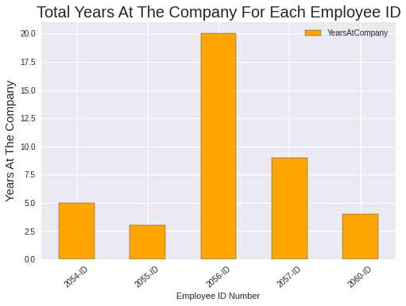

Slide 24
Coding For graph
#This graph shows the working years with us for each employee ID
plt.style.use('seaborn')
data = {'EmployeeNumber': ['2054-ID', '2055-ID', '2056-ID', '2057-ID', '2060-ID'],
'YearsAtCompany': [5, 3, 20, 9, 4]}
employee = pd.DataFrame(data,columns=['EmployeeNumber','YearsAtCompany'])
employee.plot(x ='EmployeeNumber', y='YearsAtCompany', kind = 'bar', color= 'orange', edgecolor='black');
plt.title("Total Years At The Company For Each Employee ID", fontsize=20);
plt.xticks(rotation = 40);
plt.xlabel('Employee ID Number')
plt.ylabel("Years At The Company", fontsize=15);

Slide 25
Job satisfaction for Employee id

Slide 26
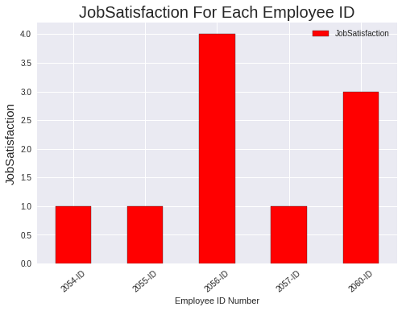

Slide 27
Coding For graph
#This graph shows the Job satisfaction for each Employee ID
plt.style.use('seaborn')
data = {'EmployeeNumber': ['2054-ID', '2055-ID', '2056-ID', '2057-ID', '2060-ID'],
'JobSatisfaction': [1, 1, 4, 1, 3]}
employee = pd.DataFrame(data,columns=['EmployeeNumber','JobSatisfaction'])
employee.plot(x ='EmployeeNumber', y='JobSatisfaction', kind = 'bar', color= 'red', edgecolor='black');
plt.title("JobSatisfaction For Each Employee ID", fontsize=20);
plt.xticks(rotation = 40);
plt.xlabel('Employee ID Number')
plt.ylabel("JobSatisfaction", fontsize=15);

Slide 28
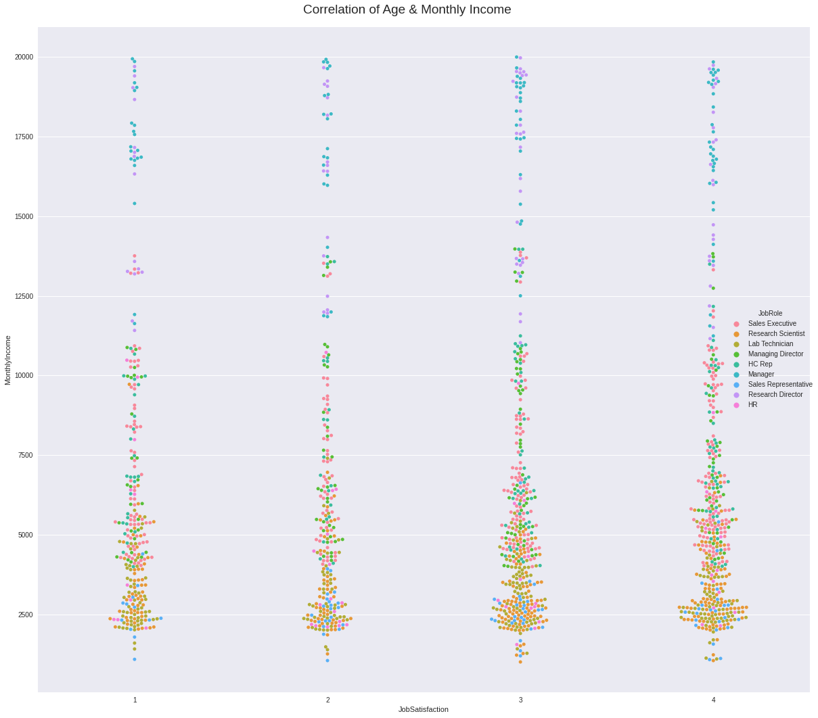
As we can see from the graph “Pay” is not a deciding factor in how ‘Happy” someone is. There are some other factors causing for employees to survey this way.

Slide 29
Coding For graph
#Shows the Correlation between Job Satisfaction and Monthly Income
w = sns.catplot(data=employee, kind="swarm", x="JobSatisfaction", y="MonthlyIncome",height= 15, hue="JobRole")
w.fig.suptitle("Correlation of Job Satisfaction & Monthly Income", fontsize=19);
w.fig.tight_layout()
w.fig.subplots_adjust(top=0.95)

Slide 30
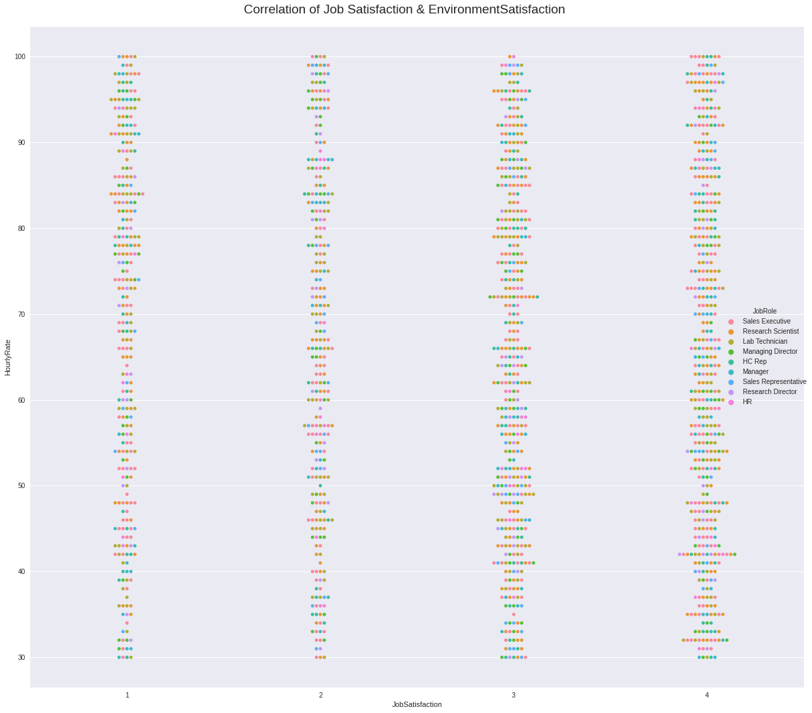
Looking at the hourly rates vs the job satisfaction, it is much like the pervious graph we saw.

Slide 31
Coding For graph
#Shows the Correlation between Job Satisfaction and HourlyRate
w = sns.catplot(data=employee, kind="swarm", x="JobSatisfaction", y="HourlyRate",height= 15, hue="JobRole")
w.fig.suptitle("Correlation of Job Satisfaction & HourlyRate", fontsize=19);
w.fig.tight_layout()
w.fig.subplots_adjust(top=0.95)

Slide 32
Conclusion :
Overall, our capacity to keep employee’s Happy with Job roles is not the greatest, and a part of that is the fact of employees not having a certain level of Job Satisfaction. Which in turn could cause the employees affected to cause others to feel the same way. Negative thoughts input : Negative outputs.

Slide 33
Recommendations :
Be flexible
Allow employees to shape their own roles
Stop micro-management
Recognize and reward – outside financial remuneration
Drive communication and transparency
Promote good health
Training and investment
Embed a strong, sociable culture

Slide 34

Thank you

